Slide 1
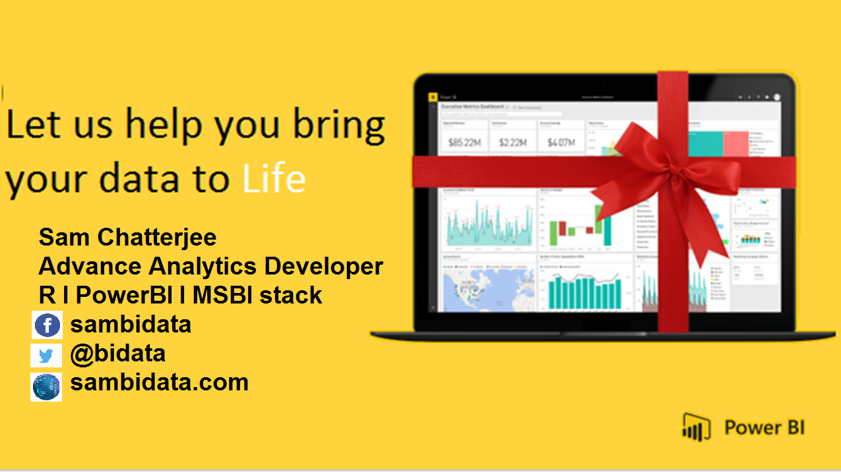

Slide 2

D A X
DATA ANALYSIS AND EXPRESSIONS

Slide 3
Why We need to Learn DAX?
DAX is a formula language associated with the Data modelling.
DAX contains important functions that can be use in Excel Power Pivot.
DAX is only associate with PowerBI.
It’s quite easy to create a new Power BI Desktop file and import some data into it. You can even create reports that show valuable insights without using any DAX formulas at all. But, what if you need to analyze growth percentage across product categories and for different date ranges? Or, you need to calculate year-over-year growth compared to market trends? DAX formulas provide this.
DAX associated with PowerBI

Slide 4
How will you Learn DAX?
By practicising it with your datasets.
By analysing the data and the query given.
What will you gain after DAX?
Creation of amazing data modelling and functions.
It works with relational databases that perform dynamic aggregations.
Can create the difference between excel and dax functions.

Slide 5

How a DAX function is written?

Slide 6
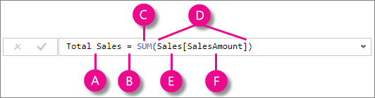

This formula includes the following syntax elements:
A. The measure name Total Sales.
B. The equals sign operator (=) indicates the beginning of the formula. When calculated, it will return a result.
C. The DAX function SUM adds up all of the numbers in the Sales[SalesAmount] column.
D. Parenthesis () surround an expression containing one or more arguments. All functions require at least one argument. An argument passes a value to a function.
E. The referenced table Sales.
F. The referenced column [SalesAmount] in the Sales table. With this argument, the SUM function knows on which column to aggregate a SUM.
When trying to understand a DAX formula, it is often helpful to break down each of the elements into a language you think and speak every day. For example, you can read this formula as:

Slide 7
DAX EXPRESSIONS
Each DAX function is hyperlinked to DAX functions details that have the DAX function description.
Each one is classifed based on
a) Descriptions
b) Syntax.
c) Parameters.
d) Return values.
e) Remarks.
f) Examples.
DAX functions parameters naming conventions
it facilitate the usage and understanding of the DAX functions.
it prefixes to the parameter names.
if the prefix is clear enough you can use the prefix itself as the parameter name.

Slide 8
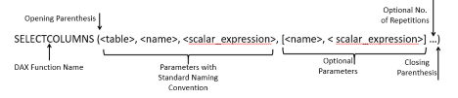
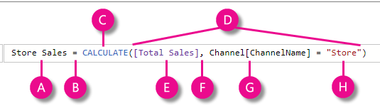
DAX FUNCTIONS

Slide 9
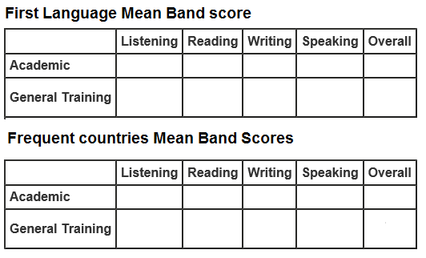
DAX
So, I need to create a table which should be look like this

Slide 10
DAX Functions
Therefore, I need to find the average of each column using this DAX expression
AVERAGE Function (DAX)
AVERAGE(<column>)
The column that contains the numbers for which you want the average.
Example
ListeningM = AVERAGE( ‘Acad first Language’[Reading])
Use
This function takes the specified column as an argument and finds the average of the values in that column

Slide 11
DAX Functions
Therefore, If I need to find the average airthmetic mean of each column , I can use this DAX expression
AVERAGEA Function (DAX)
Returns the average (arithmetic mean) of the values in a column. Handles text and non-numeric values.
AVERAGEA(<column>)
Example
ListeningM = AVERAGEA( ‘Acad first Language’[Reading])
Use
The AVERAGEA function takes a column and averages the numbers in it, but also handles non-numeric data types

Slide 12
DAX Functions
Therefore, If I need to find the average airthmetic mean of each column , I can use this DAX expression
AVERAGEX Function (DAX)
Returns the average (arithmetic mean) of the values in a column. Handles text and non-numeric values.
AVERAGEX(<table>,<expression>)
Example
ListeningM = AVERAGEx( ‘Acad first Language’[Reading])
Use
The AVERAGEX function enables you to evaluate expressions for each row of a table, and then take the resulting set of values and calculate its arithmetic mean.
The function takes a table as its first argument, and an expression as the second argument.

Slide 13
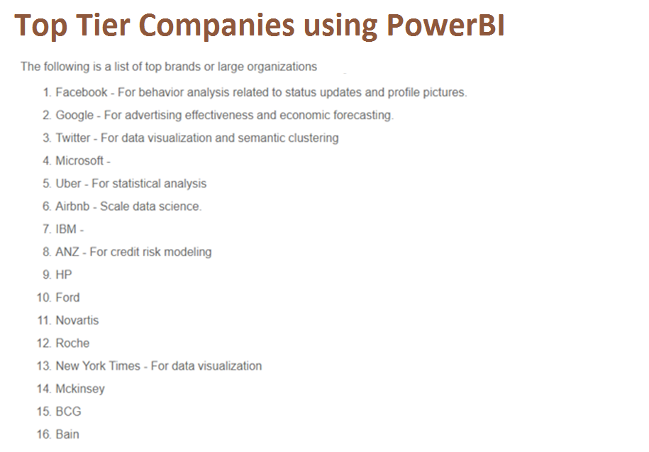
What will you achieve with PowerBI

Slide 14
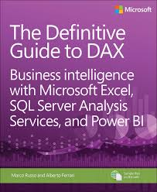

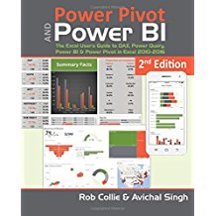

Resources
Get Power BI (Free) http://tinyurl.com/hj5hdg6
Power BI Jump Start http://bit.ly/1ktON16
Power BI Getting Started http://bit.ly/1FF88KA
Power BI Team Blog http://bit.ly/1vwbTLG
Power BI Channel 9 http://bit.ly/1a9Q0gv
Power BI https://powerbi.microsoft.com

Slide 15
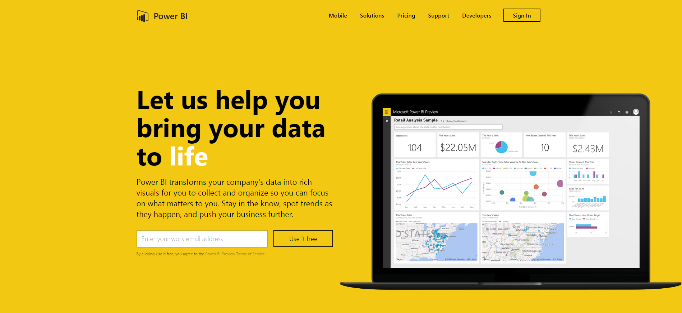
Thankyou for Coming to PowerBI
Sign up for a free Preview account
Take the Power BI Tour
Notes:
Thanks for taking the time to walk through the main capabilities of Power BI.
If you’re ready to start exploring what Power BI can do for you and your organization, please visit powerbi.com.

